Slide 1
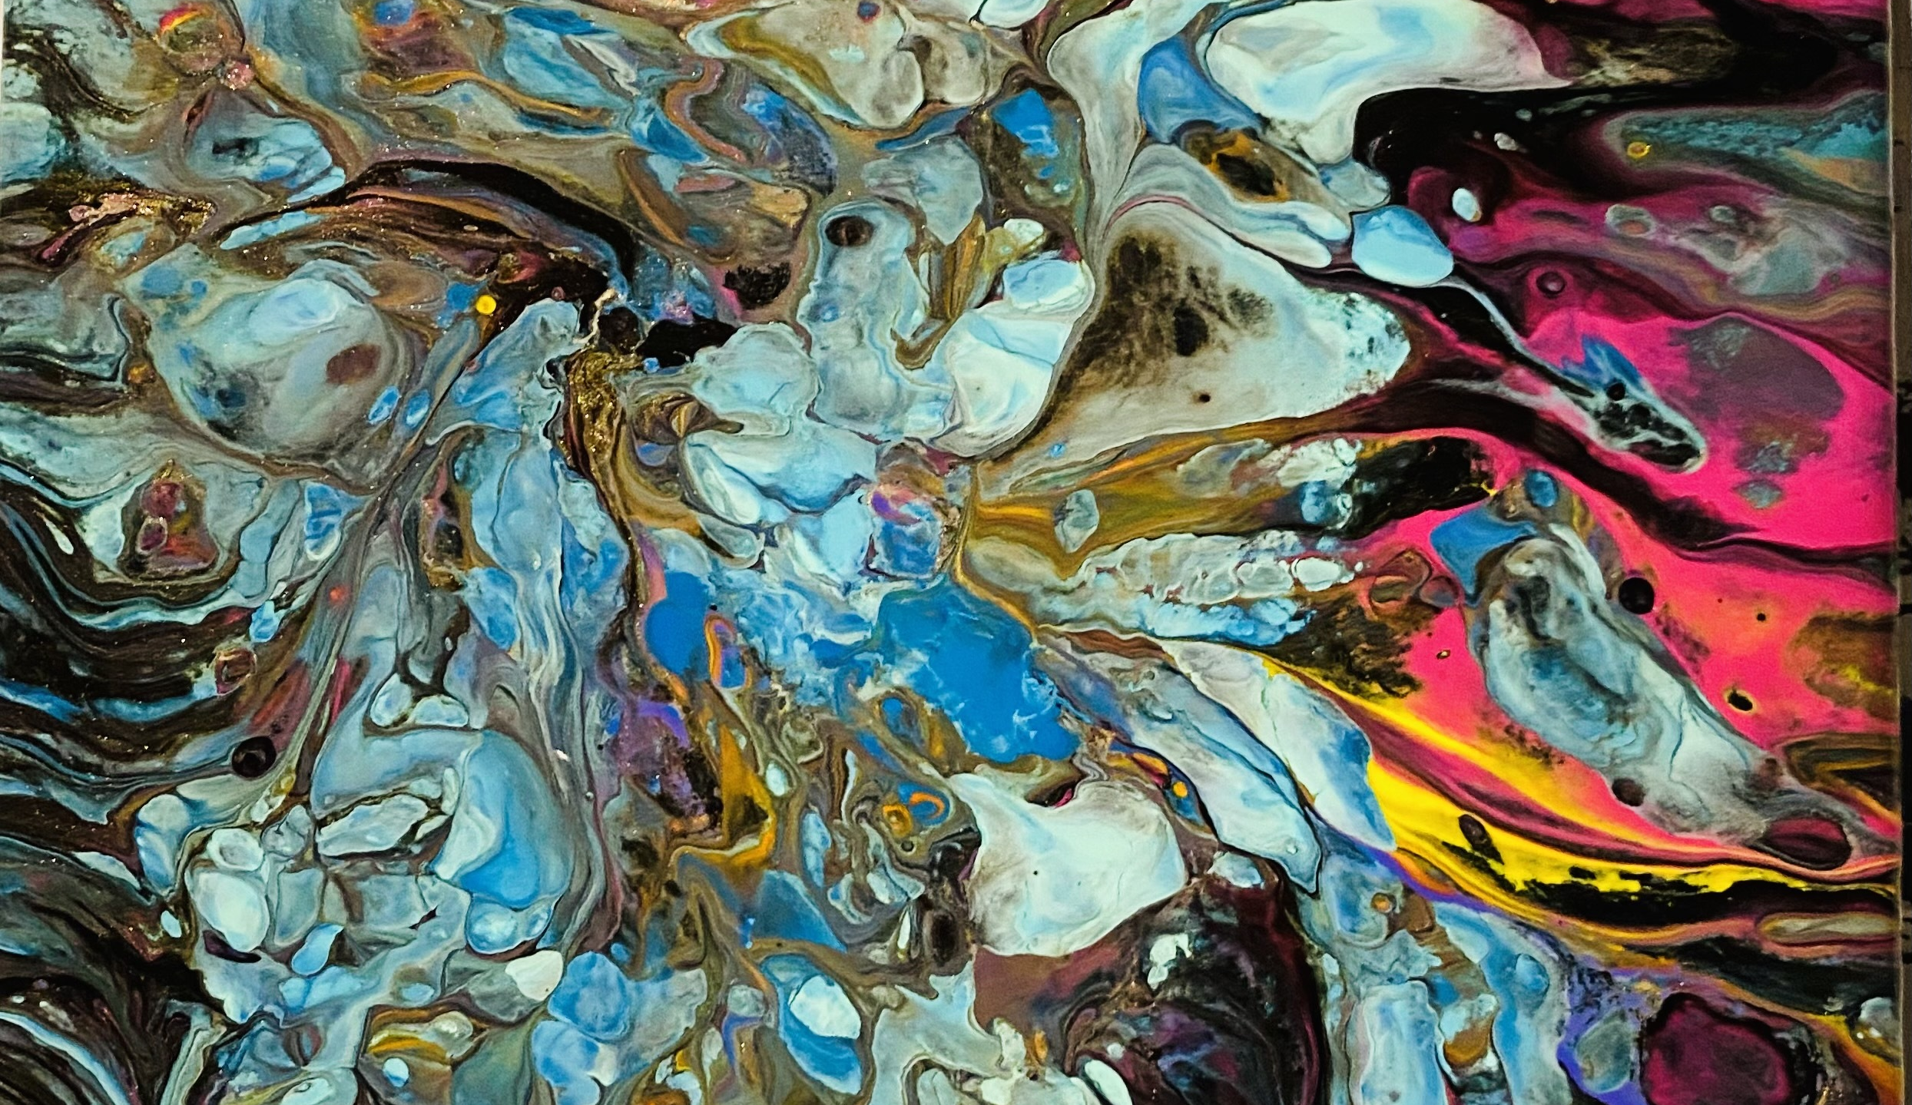
Laura Anson
Instructional Designer
LMS Highlights

Slide 2
I have a lot of experience in THRIVE, an LMS by Lessonly. I have created lessons, converted lessons, created and maintained curriculum paths, taught others how to use THRIVE, uploaded SCORMS, and used the reporting options in THRIVE. Here are a few highlights. Due to THRIVE being a company LMS, I cannot share most of these materials. On the next page, I have preview links to view a course I created in THRIVE.
I built a THRIVE lesson that linked learners to a web-based training on pronouns, called Pronouns Matter. View the video to this lesson in my video portfolio.
I completed an interactive guide for both learners and facilitators called Completing the Sale. This included a downloadable “create as you learn” sales cheat sheet, learner paths and a facilitator guide with team and self guided learning.
Created Competitive Comparison Huddle Guide and converted it to THRIVE for multiple lines of business. This was a video led course with role play practice, policy review and practical application of policy and new tools.
New “Call Flow” for Telesales Interaction Guide. I initially created a web-based training and then converted it for multiple lines of business to use in THRIVE.
Completed reorg with updates in short turn around time for T-Mobile’s First Team of Experts Home Internet Conversion Training to Pilot Home Internet Sales: New lessons, updated lessons, Re-pathed and personalized for different lines of business.
Partnered with team member to convert Telesales materials from PowerPoint and Word to THRIVE while updating materials. I became primary owner of Legacy Magenta Telesales Paths and Curriculum. Knowing we had a lot of updates coming up and this would be our trainers first time in THRIVE, I wanted to provide our trainers with an easy one stop shop for updates, prep and anything the trainer needs to be prepared. Rather than a basic prep guide, I added a few additional details such as a page for big curriculum changes. I also trained the trainers in THRIVE during their TTT.
With the Customer Care Leadership Development Team, I created a lot of leadership development in and out of THRIVE and other LMS. I was able to work through an entire AGILE ADDIE process from beginning to end on multiple projects for leaders throughout the company.

Slide 3
Facilitator Guide
Overview & Purpose
DIY Activity: What is the Interaction Guide
DIY Activity: Interaction Guide Practice
Class Activity: Applying the Interaction Guide
DIY activity- One more Time
Learner Path
Overview & purpose
DIY Activity: What is the Interaction Guide
DIY Activity: Interaction Guide – Starters
  Interaction Guide – IM & More Part 1
  Interaction Guide – IM & More Part 2
  Interaction Guide – IM & More Part 3
  Interaction Guide – Close it out
Class Activity: Applying the Interaction Model
DIY Activity-One More time
  One More Time - Continued

